Slide 1

#GRIPJULY21 TASK 1 : BASIC BANKING SYSTEM BY SHUBHAM KAUSHIK
THE SPARK FOUNDATION
WEB DEVELOPMENT INTERNSHIP

Slide 2


Slide 3
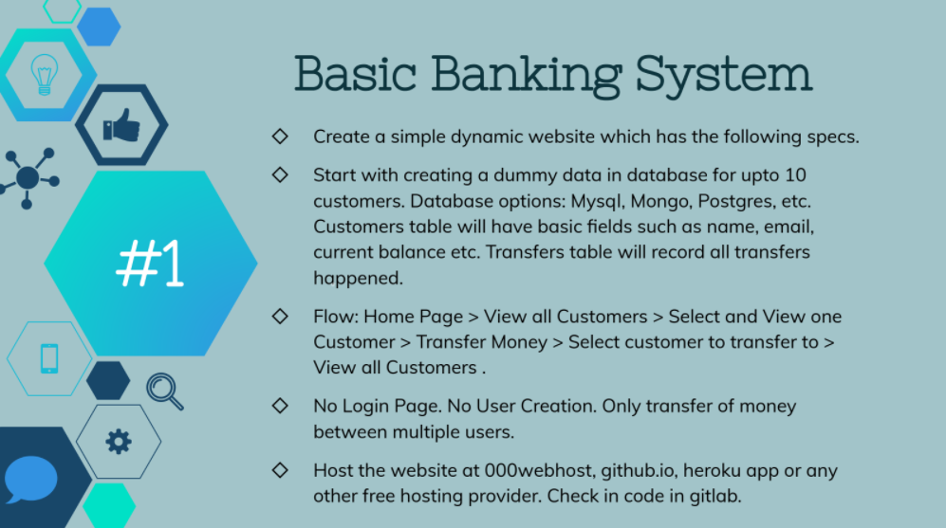

Slide 4
A Web Application used to transfer money between multiple users.
In this project using: HTML
Javascript
Node-js
Express-js.
Flow : Home Page > View all customers >Click on send money>Type the Sender's & Receiver's name,amount>Send Money>View all Customer's transaction.

Slide 5
THANK YOU

